Slide 1

K-MEANS CLUSTERING

Slide 2
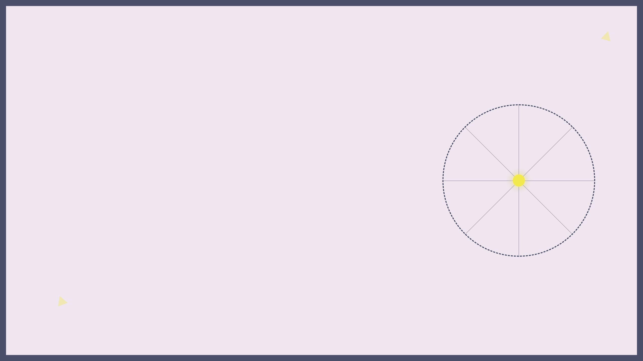


THE MATHEMATICAL HEART
Defining Centroids
A centroid represents the arithmetic mean (average) of all data points within a specific cluster, serving as its geometric center.
Distance Metrics
Proximity is typically measured using Euclidean distance.

Slide 3
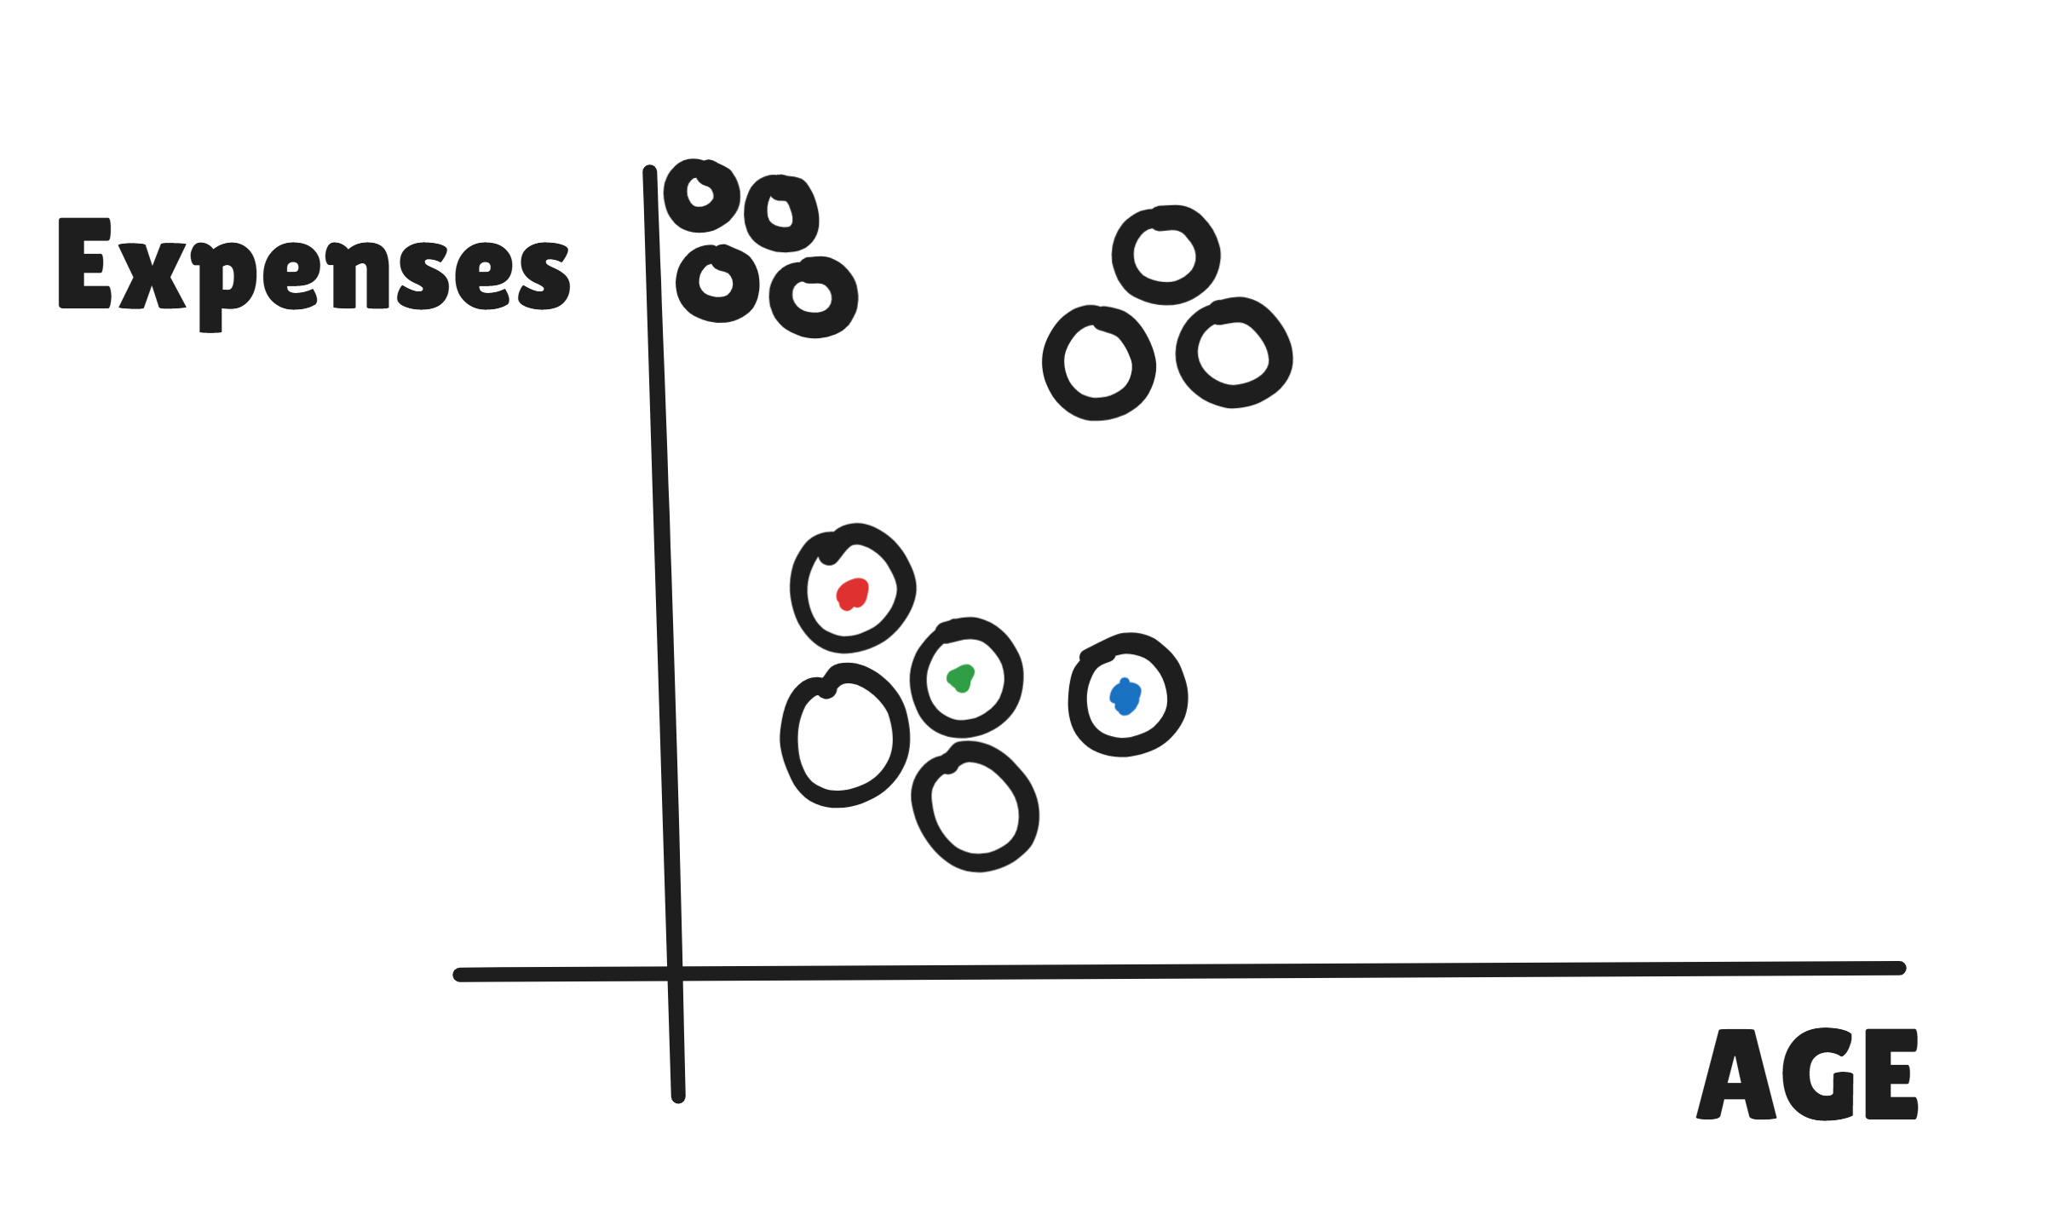

Slide 4
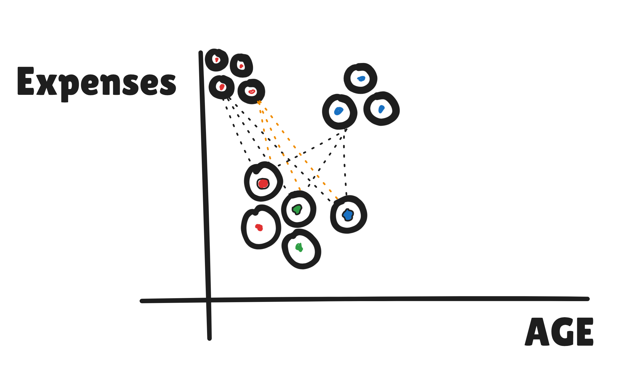

Slide 5
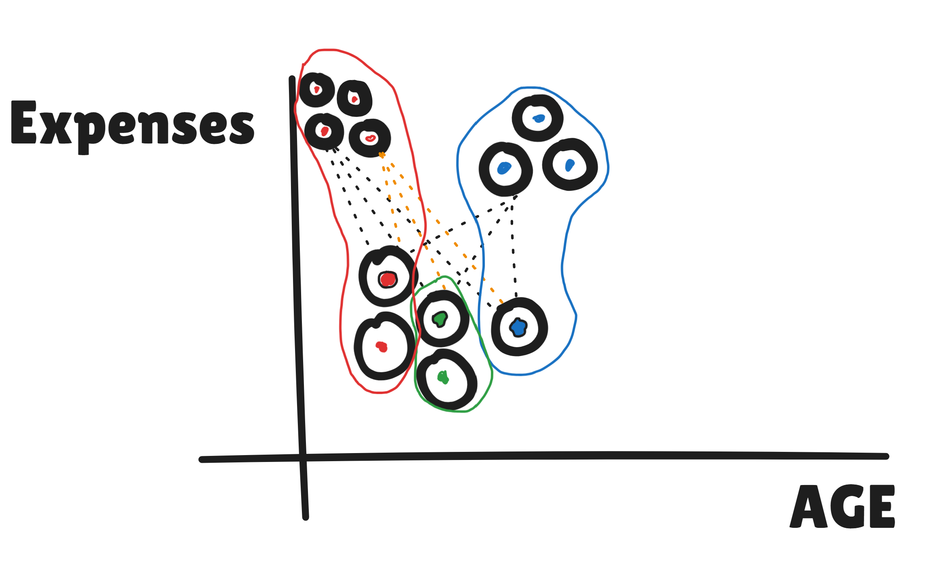

Slide 6
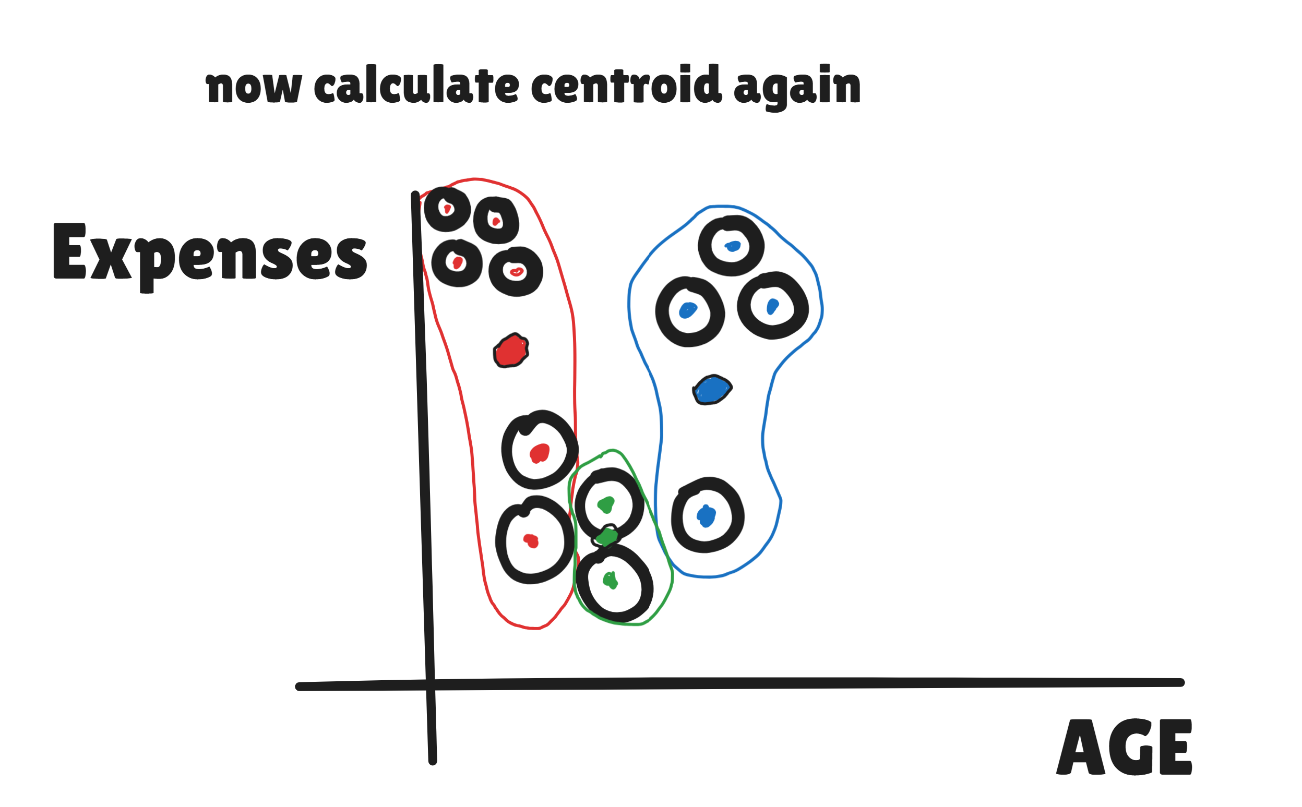

Slide 7
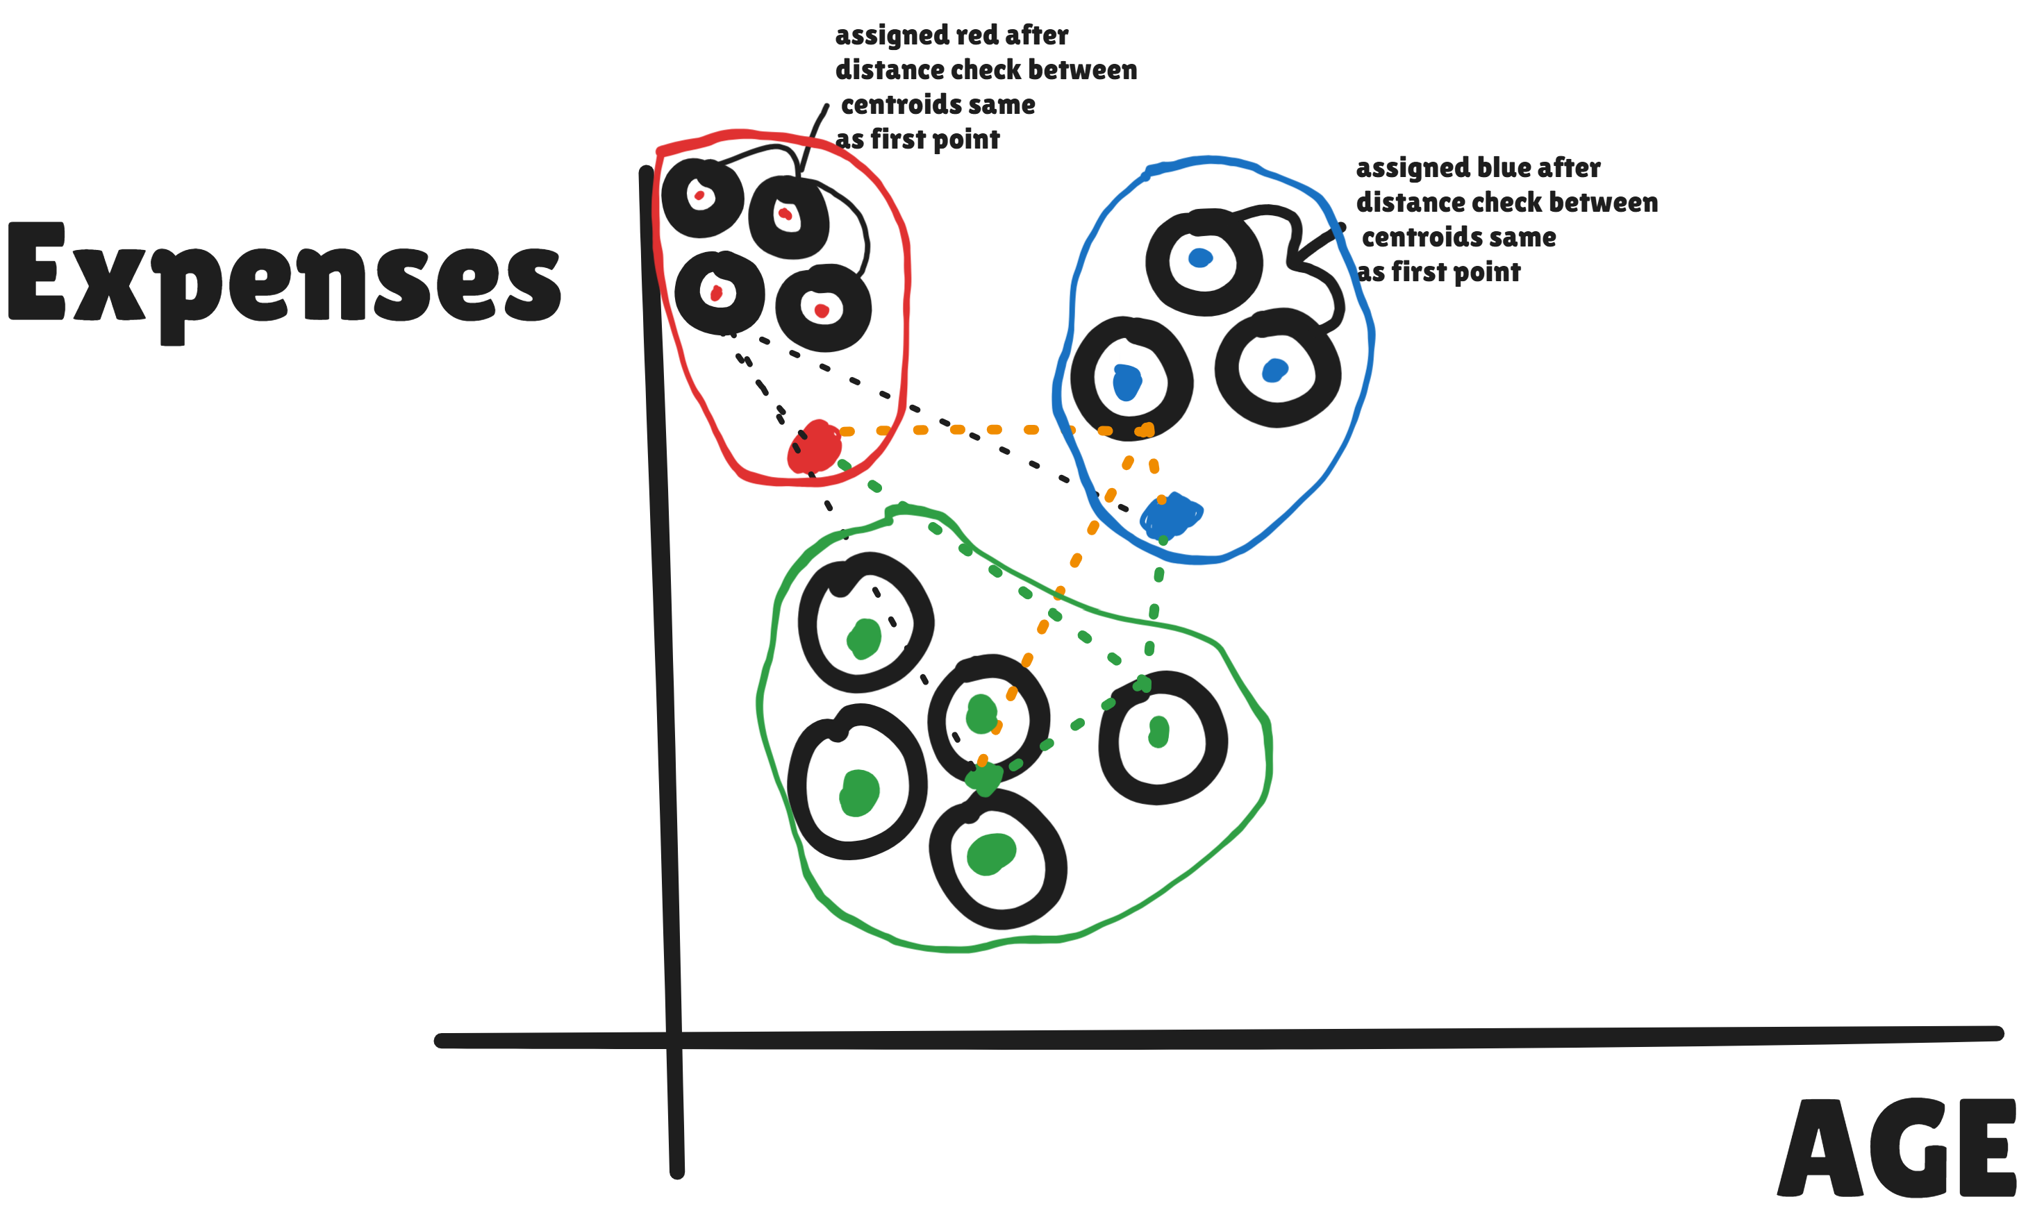

Slide 8
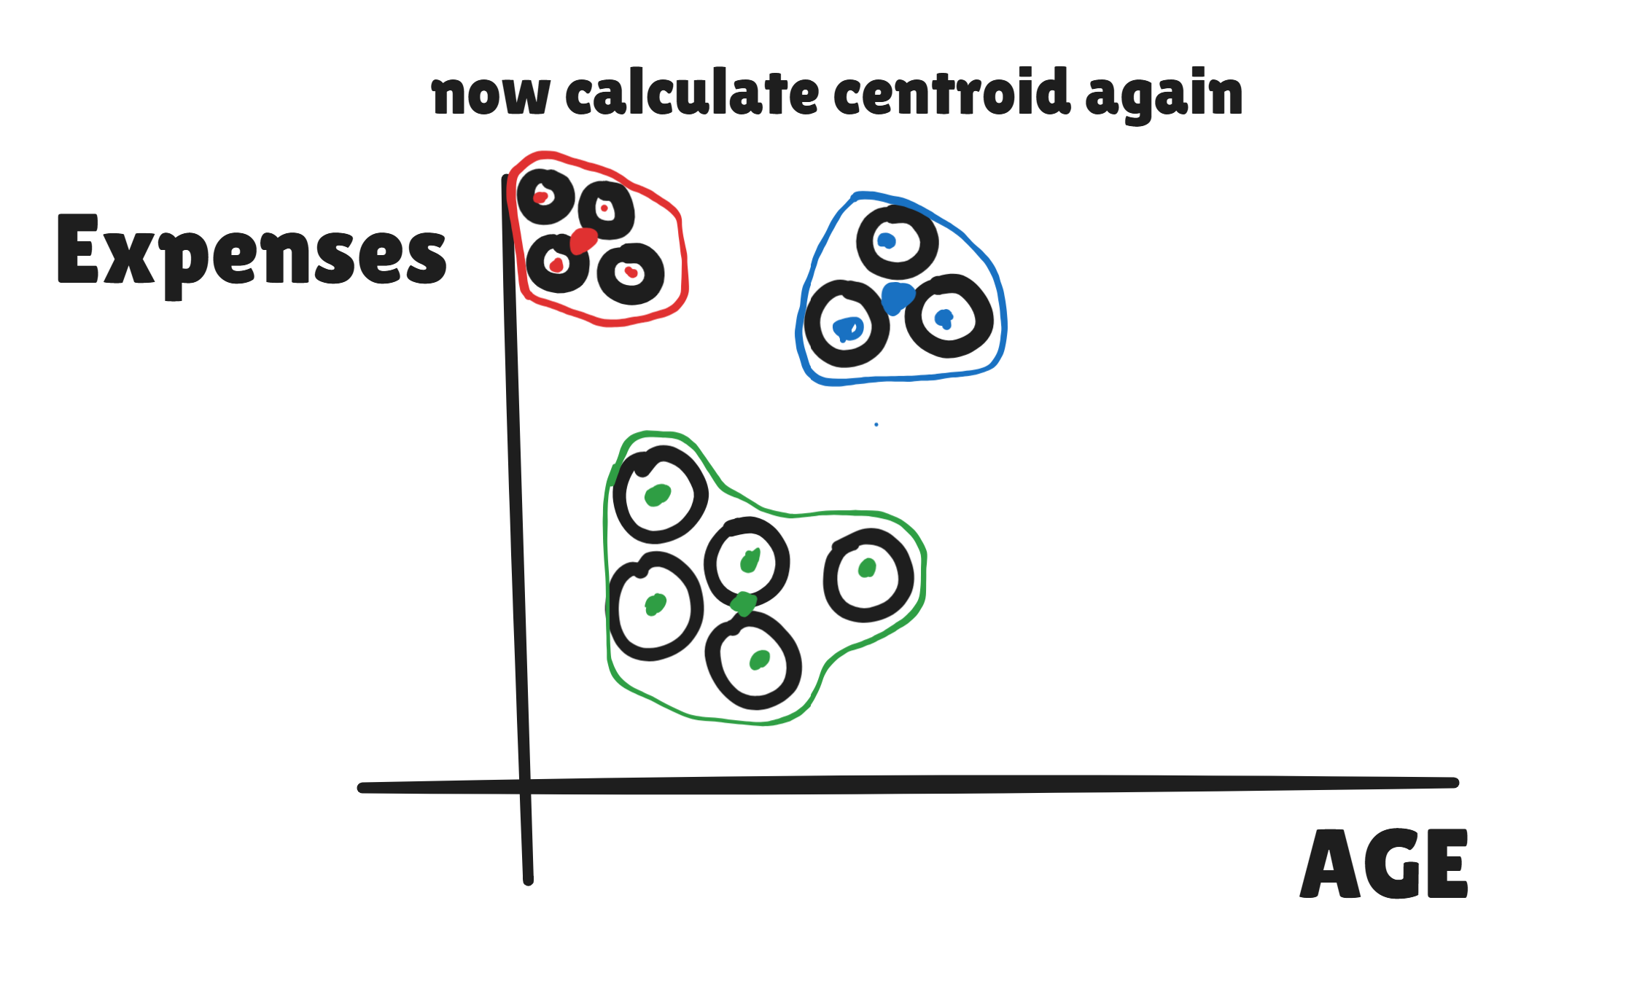

Slide 9


THE FOUR-STEP ITERATIVE CYCLE
1. INITIALIZATION
Randomly select 'K' starting points from the dataset to act as the initial cluster centroids.
4. CONVERGENCE
2. ASSIGNMENT
Repeat steps 2 and 3 until centroid positions stabilize or the maximum iteration limit is reached.
Map every data point to its closest centroid based on Euclidean distance calculations.
3. UPDATE
Calculate the new arithmetic mean of all points in each cluster and shift the centroid to this new location.

Slide 10

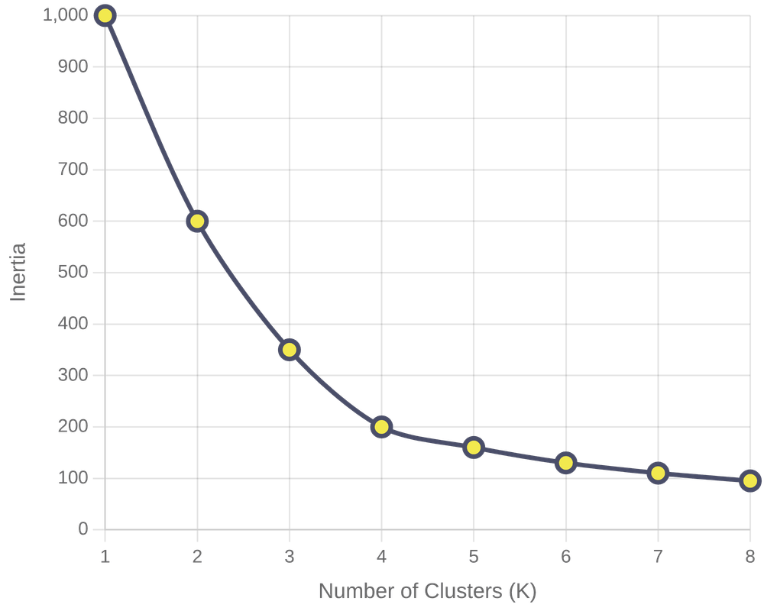
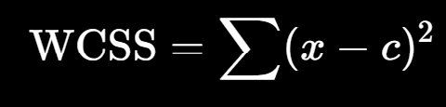



THE ELBOW METHOD
Understanding Inertia
Inertia (WCSS) measures the sum of squared distances between points and their centroids. Lower inertia indicates more compact clusters.
The Elbow Point
By plotting inertia against K, we identify the "Elbow"—the point where adding more clusters yields diminishing returns in error reduction.
Optimal Balance
Typical Elbow Plot: Inertia vs. Number of Clusters (K)
The elbow represents the ideal trade-off between model accuracy and computational complexity.

Slide 11
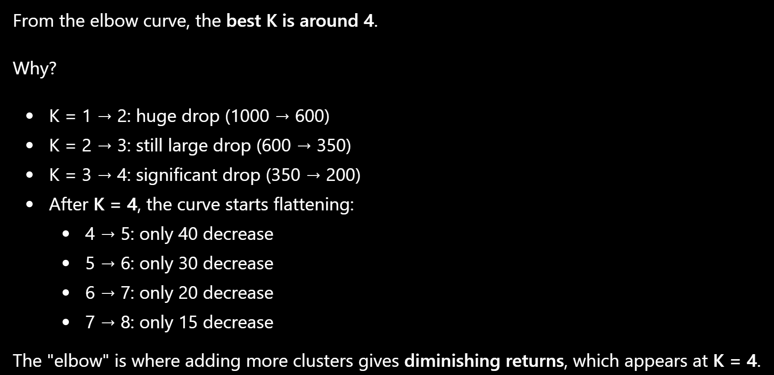

Slide 12





REAL-WORLD APPLICATIONS
CUSTOMER SEGMENTATION
IMAGE COMPRESSION
Retailers analyze purchasing behavior to group customers for highly targeted marketing campaigns and personalized loyalty programs.
By clustering similar pixel values and replacing them with centroid colors, K-Means significantly reduces file sizes while preserving visual structure.
ANOMALY DETECTION
DOCUMENT ORGANIZATION
In cybersecurity and finance, data points that fall significantly far from any cluster centroid are flagged as potential fraud or system failures.
Large digital libraries use K-Means to automatically categorize millions of documents into intuitive topics like Finance, Technology, or Healthcare.

Slide 13



BALANCING SIMPLICITY & LIMITATIONS
Key Strengths
Critical Constraints
Computational Efficiency
Outlier Sensitivity
Scales gracefully to massive datasets and is guaranteed to reach convergence quickly.
Extreme values can disproportionately pull centroids away, distorting cluster boundaries.
Ease of Implementation
Straightforward mathematical logic makes it highly interpretable and easy to deploy.
Geometric Bias
Naturally seeks spherical clusters, struggling with elongated or complex non-linear shapes.

Slide 14




FUTURE DIRECTIONS
HIGH DIMENSIONS
COMPLEX SHAPES
AUTOMATION
Integrating Principal Component Analysis (PCA) to reduce noise and overcome the "curse of dimensionality" before clustering.
Combining K-Means with density-based algorithms like DBSCAN to handle irregular clusters and varying data densities.
Developing robust, automated methods for K-selection to minimize human bias and improve model reproducibility.
"Despite its age, K-Means remains a fundamental pillar of machine learning, providing a clear, interpretable, and high-performance starting point for understanding unlabeled data."

